Slide 1

Diagnosis of COVID-19 and its Clinical Spectrum
Group Members:
Kavya anantha rao
Tanya jain

Slide 2
Overview
Motivation
Data Preprocessing
Data Statistics and Visualizations
Self Organized Maps
Principal Component Analysis
Hierarchical Clustering
K-means Clustering
K-medoids Clustering
Insights and Conclusion

Slide 3


Slide 4
Motivation
Given the current situation and surge in COVID-19 cases, we have explored the dataset using unsupervised learning algorithms and found meaningful patterns using data mining and visualization techniques.
This dataset consists of patient data who visited Hospital Israelita Albert Einstein (São Paulo, Brazil). It consists of samples that were collected to perform the SARS-CoV-2 RT-PCR (test for COVID-19) and additional laboratory tests.
There are 5644 records for 111 columns. Data is anonymized and standardized.
We have implemented following unsupervised clustering algorithms: SOM, PCA, Hierarchical Clustering, K-means and K-medoids
We derived some insights from the data such as detecting if the suspect is positive or negative for COVID-19 with the laboratory tests conducted.

Slide 5

Data Preprocessing

Slide 6
Data Preprocessing
The obtained dataset was in unstructured form. It contained many NA values along with missing data.
Removal of records having 90% NA values
Feature selection based on the need of clustering algorithms.
Normalization of data

Slide 7


Data Statistics and Visualizations

Slide 8
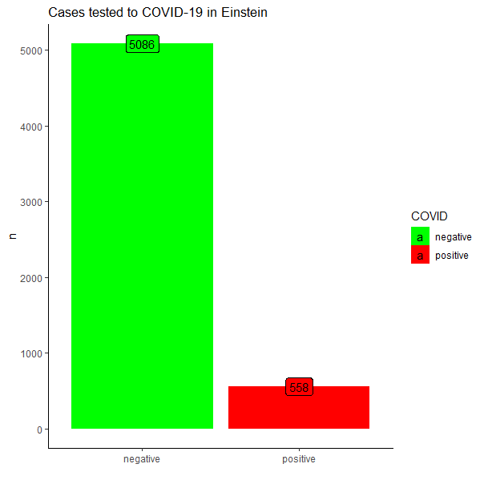
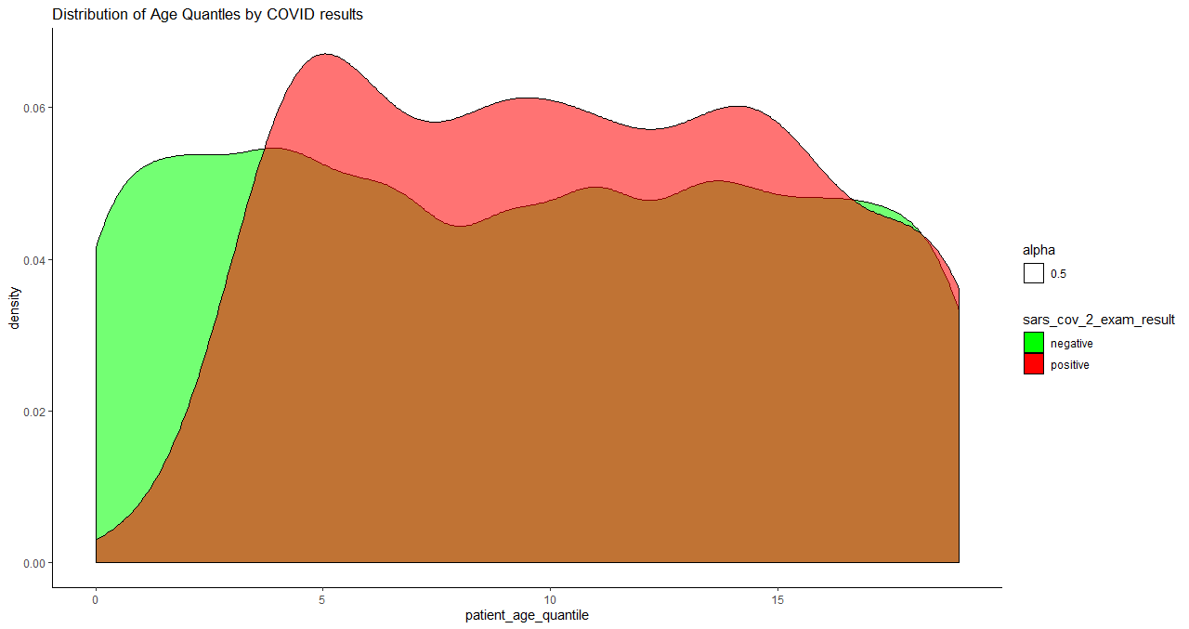
Data Statistics and Visualizations

Slide 9

Self Organizing Maps

Slide 10
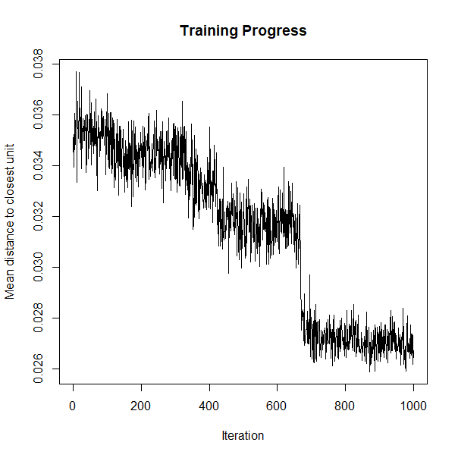
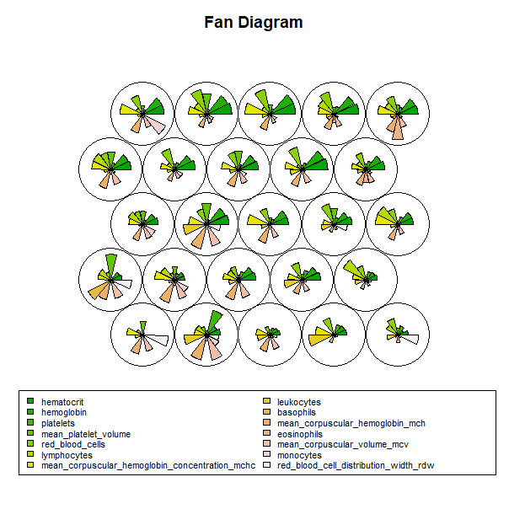
Self Organized Maps
Training Progress Plot:
Progress over time for 598 records was plot. If the progress is found to decrease continuously over time, we need to iterate SOM until the plot converges. We can see that in the graph alongside, this distance is reaching a minimum plateau at about 700 iterations.
Fan Diagram: We visualize the weight vectors/codes across the map by observing the patterns in the distribution of samples and variables. These fans represent the magnitude of each variable in the weight vector which are mapped for each node. The codebook vectors are visualized in a segments plot.
High content of Hemoglobin, Hematocrit is observed with test results projected on the map.

Slide 11
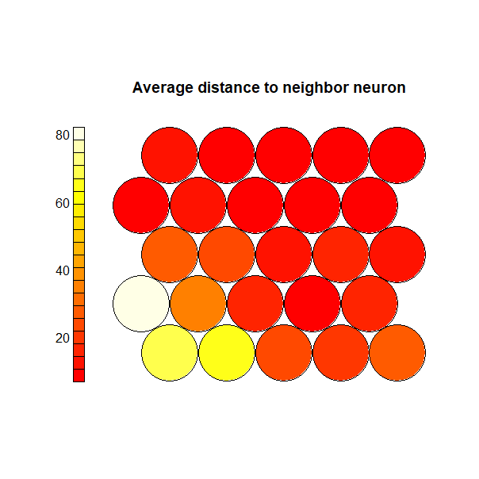
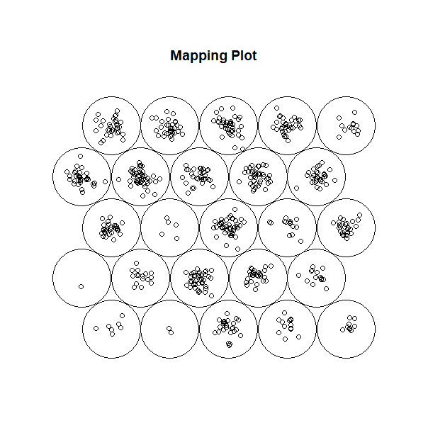
Self Organized Maps
U-Matrix plot or a neighbor distance plot. It visualizes the distance between each node and its neighbors. The nodes which have low neighbor distance are similar to each other. Areas with large distances denote that nodes are dissimilar to each other and indicate natural boundaries between node clusters.
We can see that red colored nodes form a large area that are dissimilar from yellow nodes. Thus, this plot helps us to identify clusters within SOM map.
Mapping plot shows the mapping of spectra. The locations of the circles indicate the nodes onto which patients’ data have been mapped. Thus being an indicative of the test results of COVID-19.

Slide 12
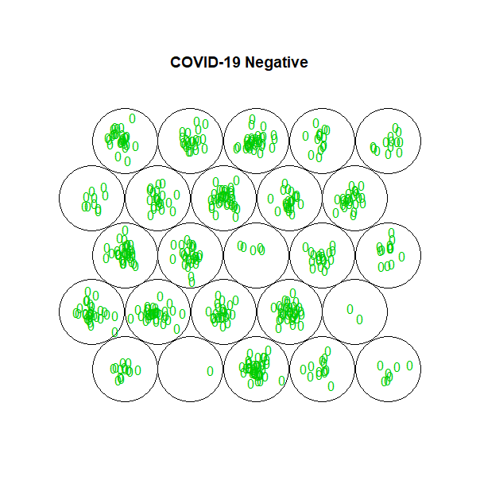
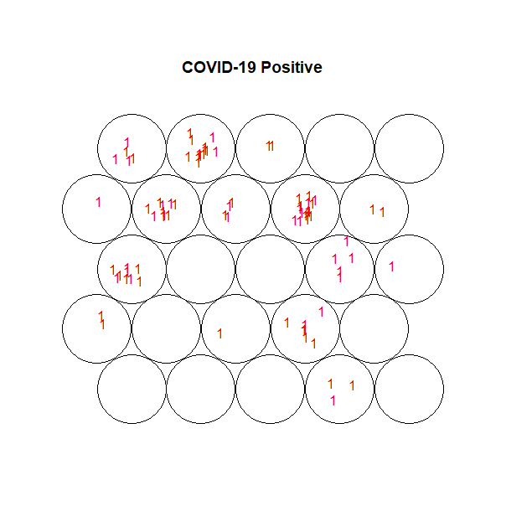
Self Organized Maps
From the routine blood laboratory tests, it was possible to classify the patients as negative or positive for COVID-19 among the suspected cases.

Slide 13
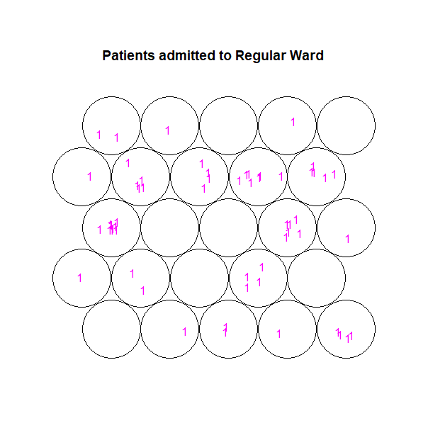
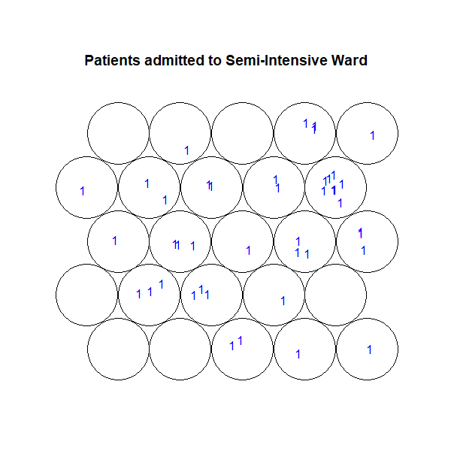
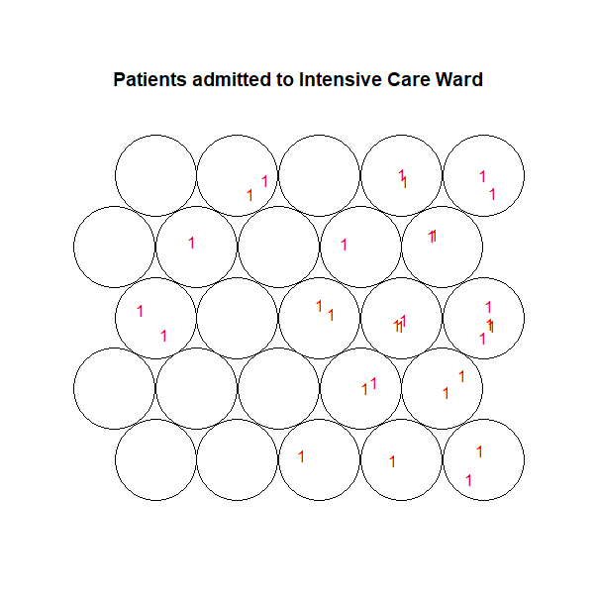
These mapping plots shows the distribution of patients in different types of wards in the hospital who were tested positive.
It was possible to classify the patients who were tested ‘positive’ and would be required to be admitted to either regular ward, semi-intensive unit or intensive care unit based on the criticality.

Slide 14
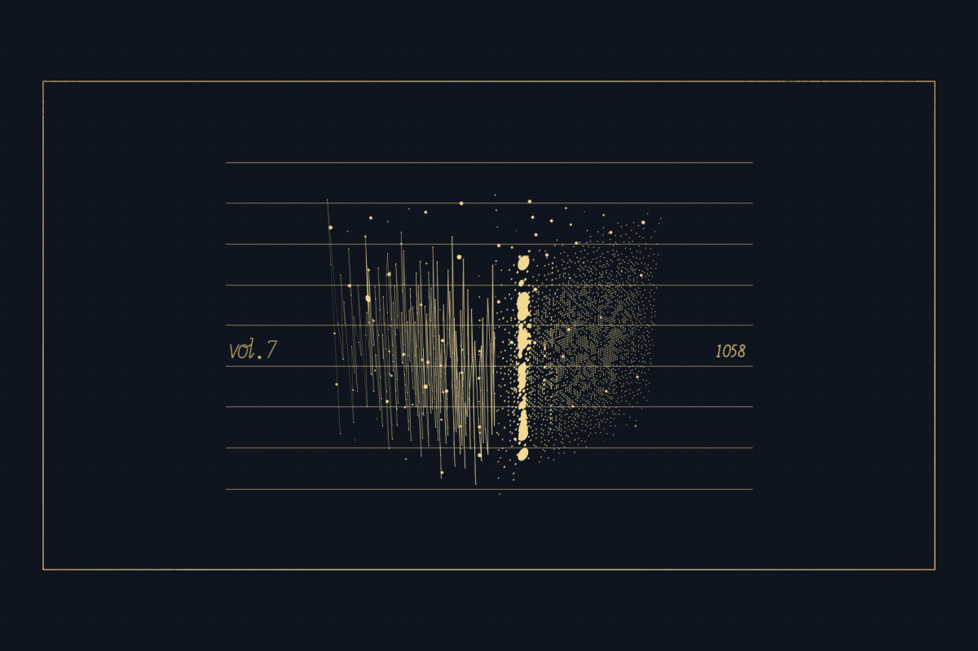
Principal Component Analysis

Slide 15
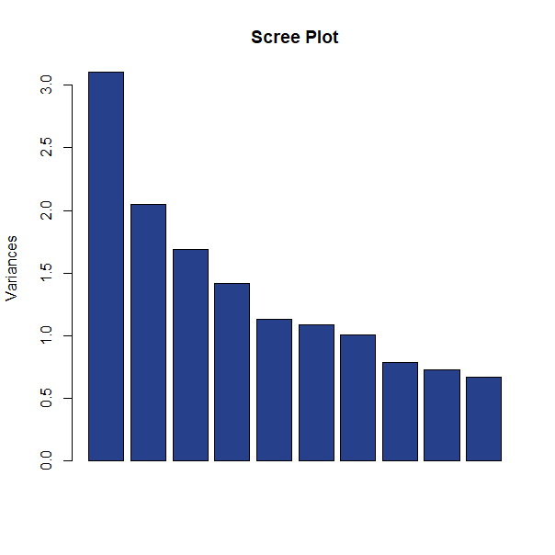
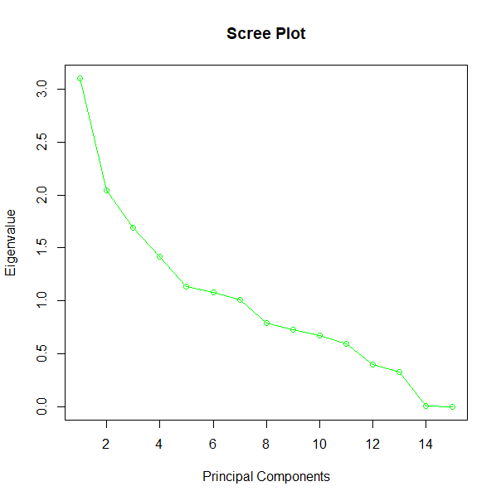
Principal Component Analysis
Objectives of PCA
Dimensionality reduction
find a linear combination of variables to create principle components
maintain as much variance in the data as possible
principal components are uncorrelated (i.e. orthogonal to each other)
Scree Plot shows the eigen values for each of the principal components and shows the variance provided by them.

Slide 16
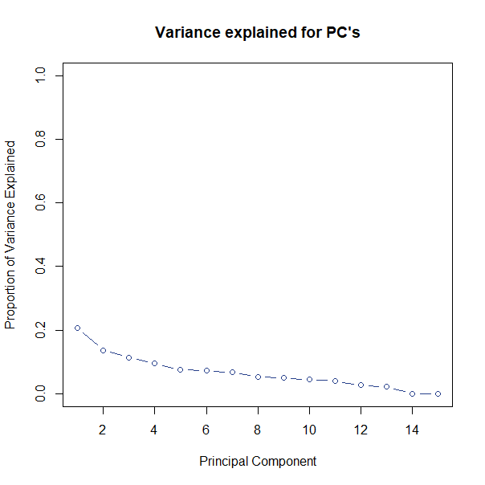
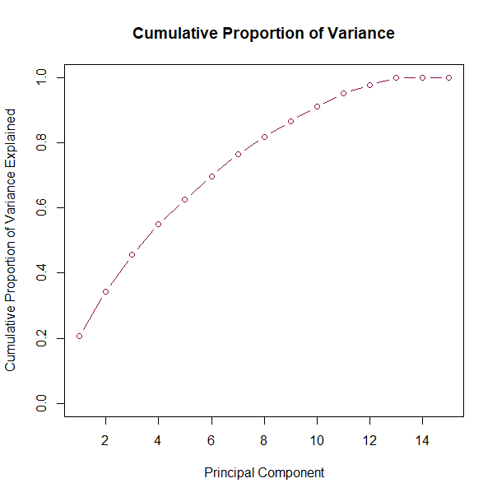
Variance explained when the number of components matches the number of original features.
Cumulative variance explained by successive principal components

Slide 17
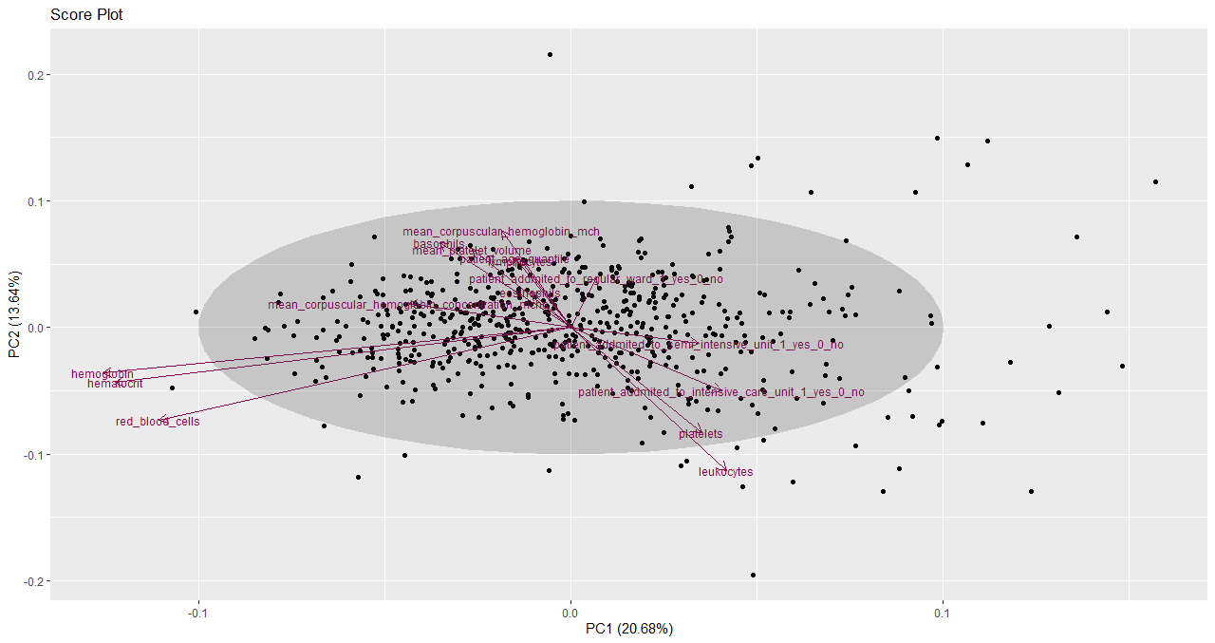
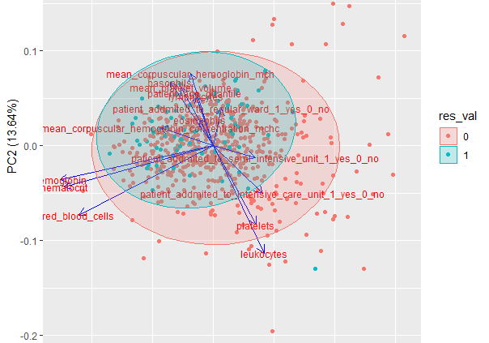
These are score plots cum biplots that are used to represent sample scores and sometimes loadings for the principal components. It involves the projection of the data onto the PC’s in two dimensions. It is a scatterplot of PC1 against PC2. Size and direction of the loading vector for each variable determines the contribution of variance of that variable for the model.
We can see that loading vector of leukocytes, hemoglobin, hematocrit is largest and in the direction of PC1 and PC12 respectively.

Slide 18
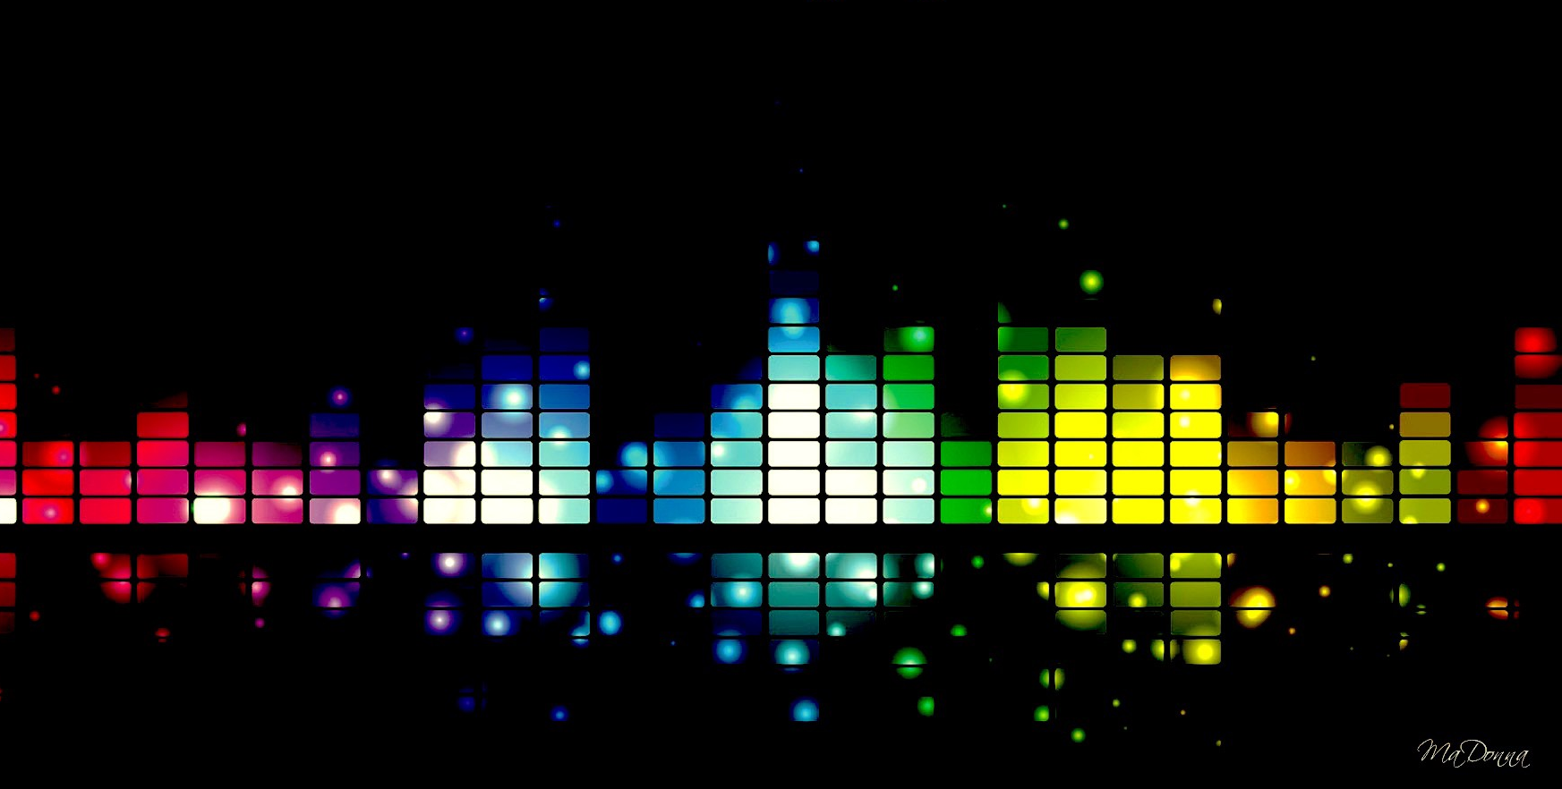
Hierarchical Clustering

Slide 19
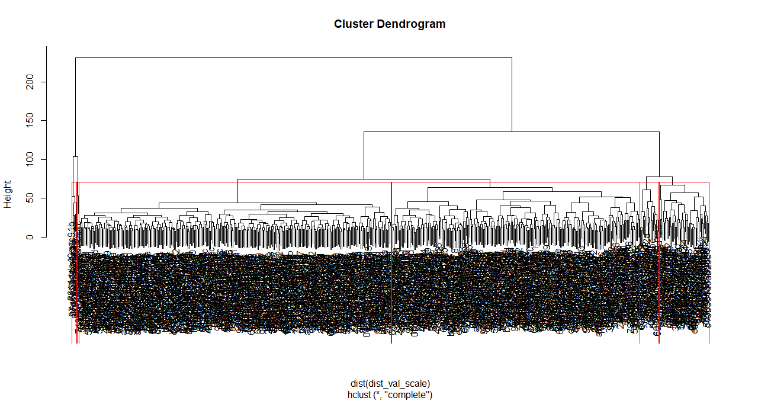
Hierarchical Clustering
Hierarchical clustering structure provides more information rather than flat clusters and assigns each data point into a cluster.
On visualizing the dendrogram, the number of clusters was chosen to be 6

Slide 20
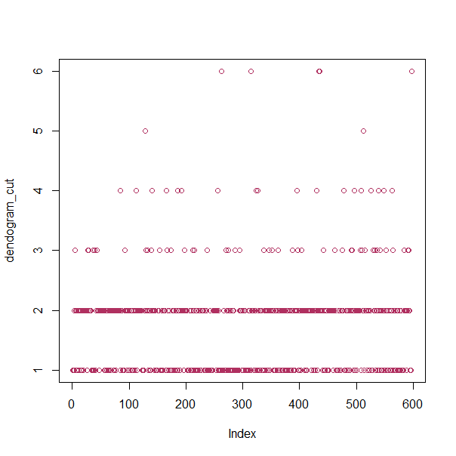
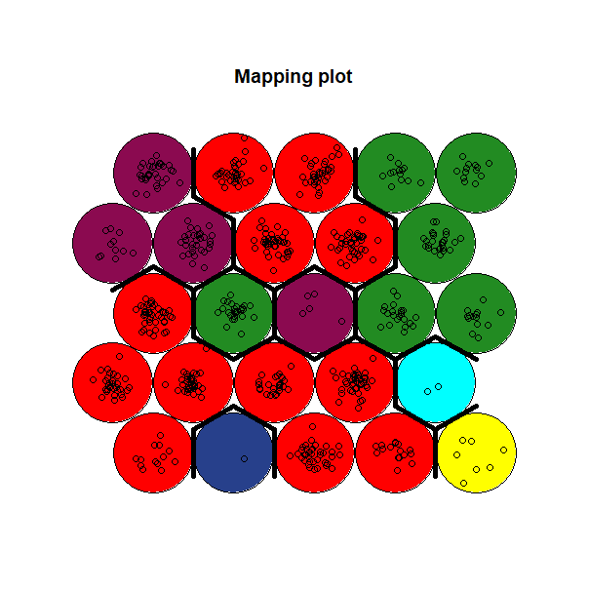
Hierarchical clustering was performed on SOM grid to obtain distinct clusters . The plot of SOM using the clustering obtained by hierarchical clustering is shown below. Each color represents a different cluster type. The SOM method characterizes the data properly into the groups and helps to display the high dimension data in 2D retaining the underlying features; though there are several features, it may be clustered into lesser number.

Slide 21

K-Means Clustering

Slide 22
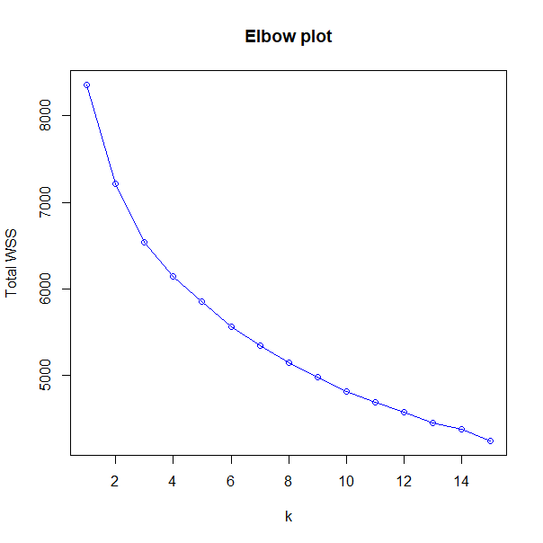
K-Means Clustering
Determining homogeneous subgroups in the records of patients in the hospital.
We provide the number of centers or groups “K” and the number of iterations. It starts by randomly assigning points to groups and then find local minimums so running it multiple times helps you find the global minimum.
Elbow Plot is used for determining optimum number of clusters where we look for the elbow. Total WSS indicates within clusters sum of squares.
Gap Statistics was also performed.

Slide 23
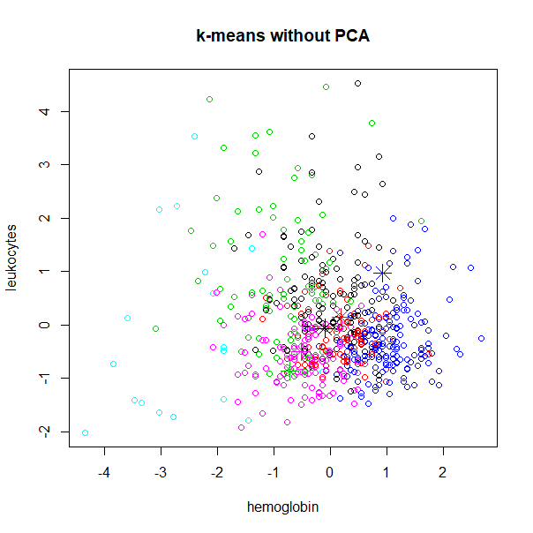
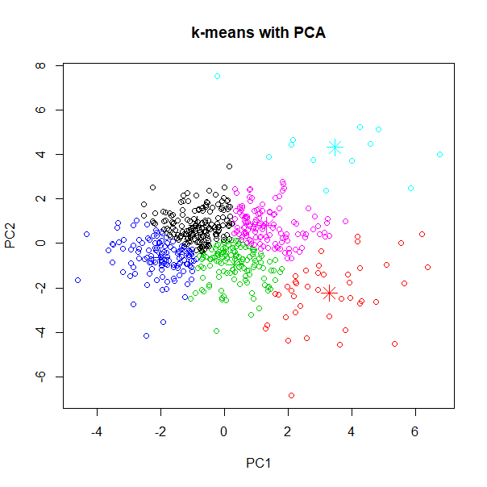
K-Means Clustering
K-means was performed with the data processed after PCA. Proper clustering was observed for K-means after dimensionality reduction.
6 distinct clusters are shown by 6 different colors in the plot.
Clustering without PCA data was plotted for 2 significant variables leukocytes and hemoglobin. Since the data was not processed with PCA, clear clusters are not formed.

Slide 24
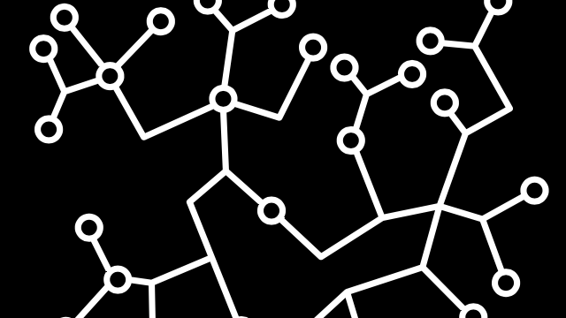
K-Medoids Clustering

Slide 25
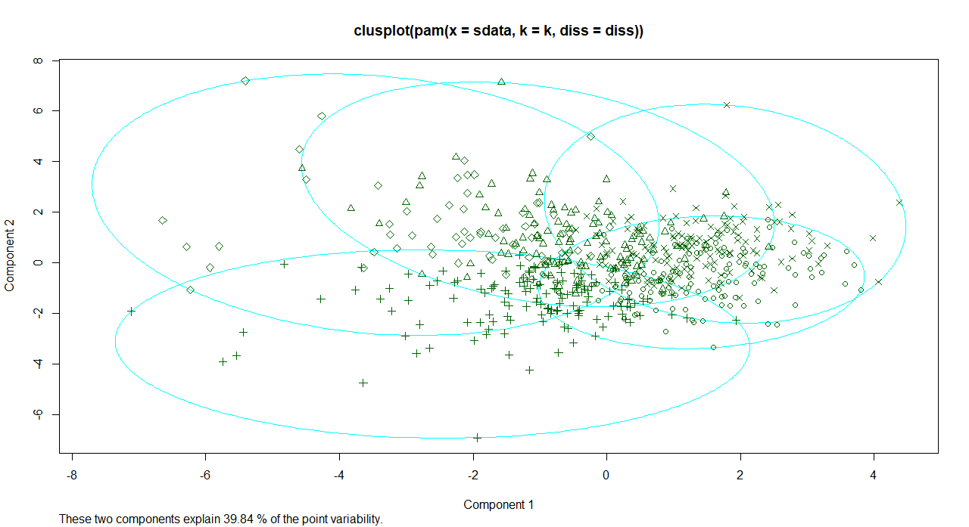
K-Medoids Clustering
K-medoids minimize the sum of dissimilarities between objects labeled to be in a cluster and one of the objects designated as the representative of that cluster(termed as mediods)
Different shapes represent 5 different clusters in the dataset.

Slide 26

Insights and
Conclusion

Slide 27
Insights and Conclusion
Algorithm | Number of Clusters | Observation
SOM | 6 | The map retains principle features of the input data at a low dimension.
PCA | NA | Useful for better visualizations in low dimension grid.
Hierarchical Clustering | 6 | It is not suitable for large datasets as determining the clusters will become difficult.
K-Means Clustering | 6 | Works better after PCA.
K-Medoids Clustering | 5 | Works better after PCA.

Slide 28
Insights and Conclusion
The limited availability of data, since many observations had large number of NAs, made it more difficult to find patterns using this method.
Features/Predictors such as hemoglobin, hematocrit and leukocytes in the blood content of patients were found to be most significant contributor for testing COVID-19 test results.
From SOM we were able to classify and visualize patients who were either positive with 558 count and negative with 5086 count.
Based on the criticality of patients we were able to classify them into which ward they should be admitted.
It was found that the elderly population was most affected.
It was possible to identify the significant features that help in detecting if the suspect has COVID-19.It was seen that the suspects confirmed positive cases were less likely to be discharged and were more likely get admitted in the intensive or semi-intensive care.

Slide 29
Data Mining over a useful dataset can give us very important insights and conclusions.
This Diagnosis of COVID-19 and Clinical Spectrum data, with further cleansing, can be used for even more analysis. But every good thing comes to an end!
Thank you for staying through!

